Slide 1
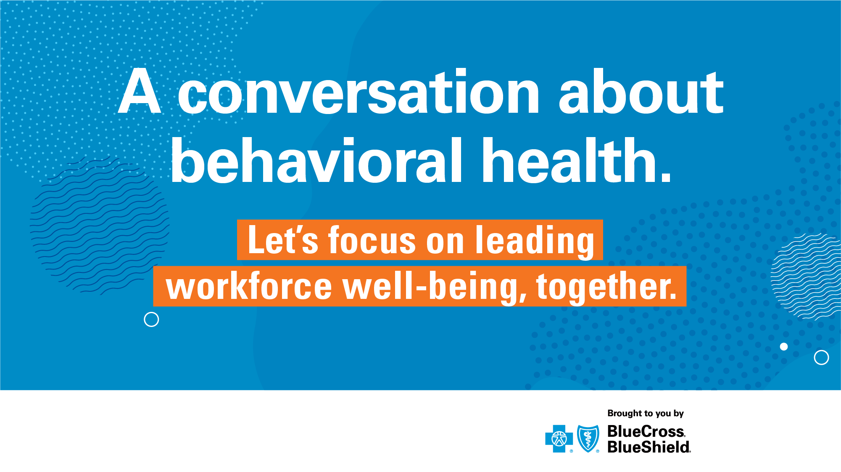

Month 00, 2020
Independence Blue Cross offers products through its subsidiaries Independence Hospital Indemnity Plan, Keystone Health Plan East and QCC Insurance Company, and with Highmark Blue Shield — independent licensees of the Blue Cross and Blue Shield Association.
Notes:
Welcome, everyone, to an important conversation.
We want to talk about something that’s really top of mind, especially now, for many business leaders—and that’s employee behavioral health.
• First, let’s clarify that the term behavioral health, while often seeming like another term for mental health, is more than that. Behavioral health is a focus on how our behaviors influence our overall health—this includes mental, emotional and physical.
• When you think of it this way, it’s something that matters to all of us. It’s something we all need to focus on in the same way we do working out or eating right.
• And there’s a growing need now, whenever talking about health, to go beyond just physical health, and talk about behavioral health as well.
So, we want everyone to focus more holistically on creating a culture of health, to bring behavioral health and well-being together, and think about how we take care of our whole selves. That includes leaders and managers. In fact, we are key influencers in all workforce well-being. Research has revealed that 62 percent of employees say having someone in a leadership role speak openly about mental health would make them feel more comfortable talking about it themselves.

Slide 2
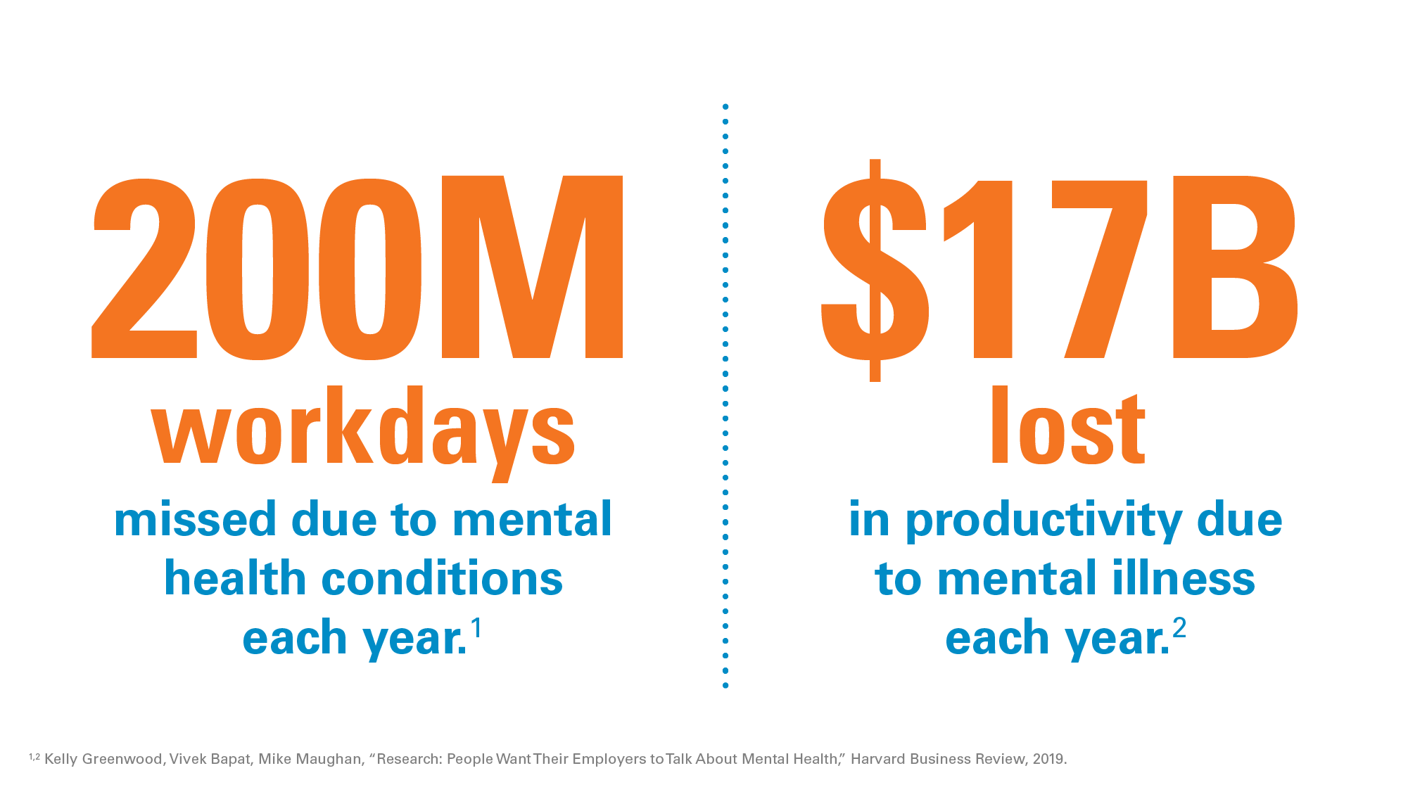
Notes:
First, let’s dive a little deeper into how real the need is, and how we get purposeful about this.
• For businesses, the impact of behavioral health on the workforce has meant over 200 million workdays lost due to mental health conditions each year, costing employers almost $17 billion in productivity. And these statistics are from before the pandemic.

Slide 3
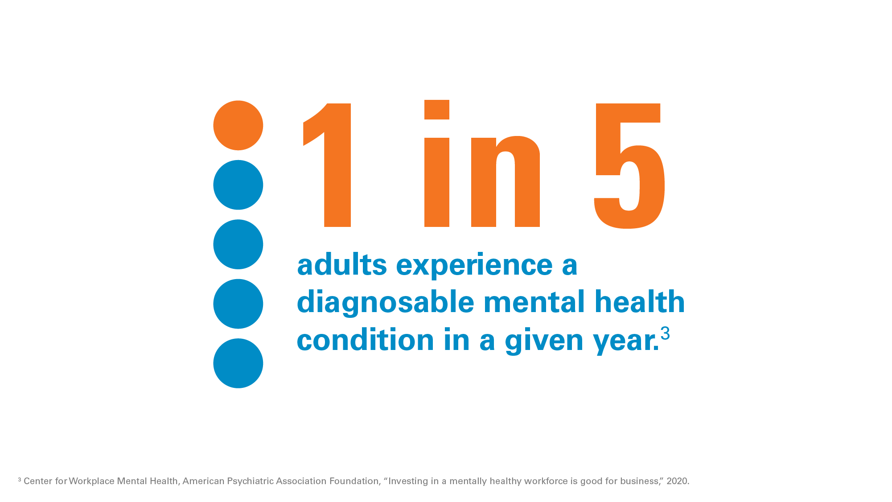
Notes:
• Research also shows 1 in 5 adults experience a diagnosable mental health condition in a given year.
• When you open that up from diagnosable conditions to workplace stress and other concerns that also affect our health every day, Harvard Business Review found that as much as 60 percent of people are affected.
• As we’re already experiencing, the stress and pressures of the pandemic have the potential to weigh on virtually all of our behavioral health. (We can see this in things like the amount of calls to the federal mental health crisis hotline being 900 percent greater in 2020 than in 2019.)
One solution is to talk about why, and what we can do about it, with employees. Because the reality is that if we don’t, a majority of those affected don’t seek or receive the support or help they need. But, finding ways to address behavioral health that really resonate with employees is a top challenge.
• The Behavioral Health Employee Communications Toolkit from Blue Cross Blue Shield can help. It can help us promote open dialogue and actively address behavioral health with our workforce around three key topics that are critical right now:
– Reducing stigma
– Managing everyday stress
– And dealing with new pressures during COVID-19 and beyond.
• Again, let’s look at the need.

Slide 4
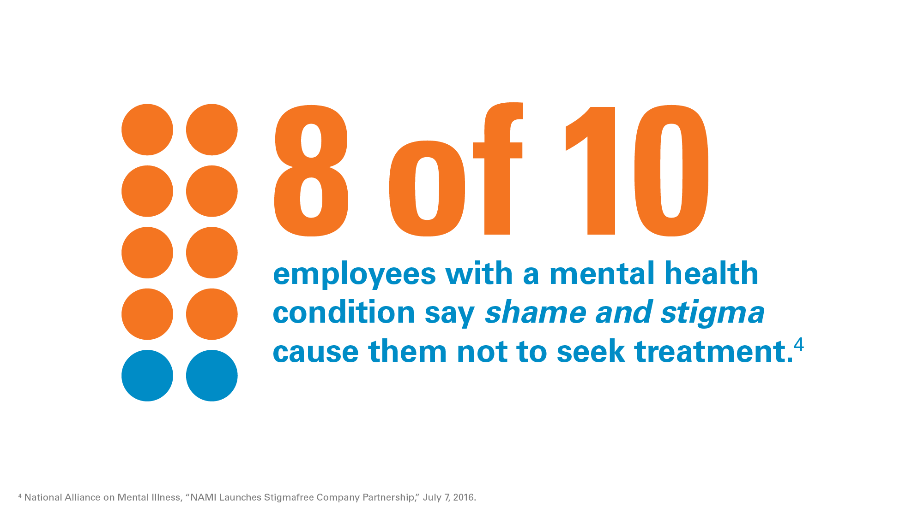
Notes:
8 out of 10 employees with a mental health condition say shame and stigma cause them not to seek treatment they need. Even if we look at the established data, 1 in 5 (or, 20 percent) of adults will experience a diagnosable mental health condition in a given year. For us, that’s XX employees. And 8 out of 10 (or 80 percent) of those employees would not seek treatment due to stigma. For us, that would be XX employees not seeking treatment.
Why is this? We have resources, insurance benefits, an Employee Assistance Program (EAP). Right?
• Research suggests almost 60 percent of employees have never spoken to anyone at work about their mental health status.
• Do all of you talk about your mental health openly?
• That’s right. This includes leadership, and if you felt uncomfortable with that question, you’re feeling the stigma that most associate with discussing mental health. And it’s a big reason why most people don’t talk about it or seek help through the resources we provide.
So, let’s look at an example of what breaking through that barrier might look like. I’m going to put up a prompt, and then I’m going to ask a couple questions. All you have to do is be honest. Ready?
We’ll start off easy. Have you ever blocked off time on your calendar because you needed to clear time to take a mental break? Yes or no?
(Watch for responses…) OK, a lot of Yeses. Let’s keep going.
Have you always been open about that time being blocked for “you time?” Yes or no?
(Watch for responses…) Oh, more Noes this time. Interesting. That’s OK. One last question…
Have you ever told an employee that you do that? Yes or no?
(Watch for responses…) I think you see the point. When we talk openly with employees about even something as simple as needing a break from the noise and stress once in a while, we are leading a culture shift.

Slide 5
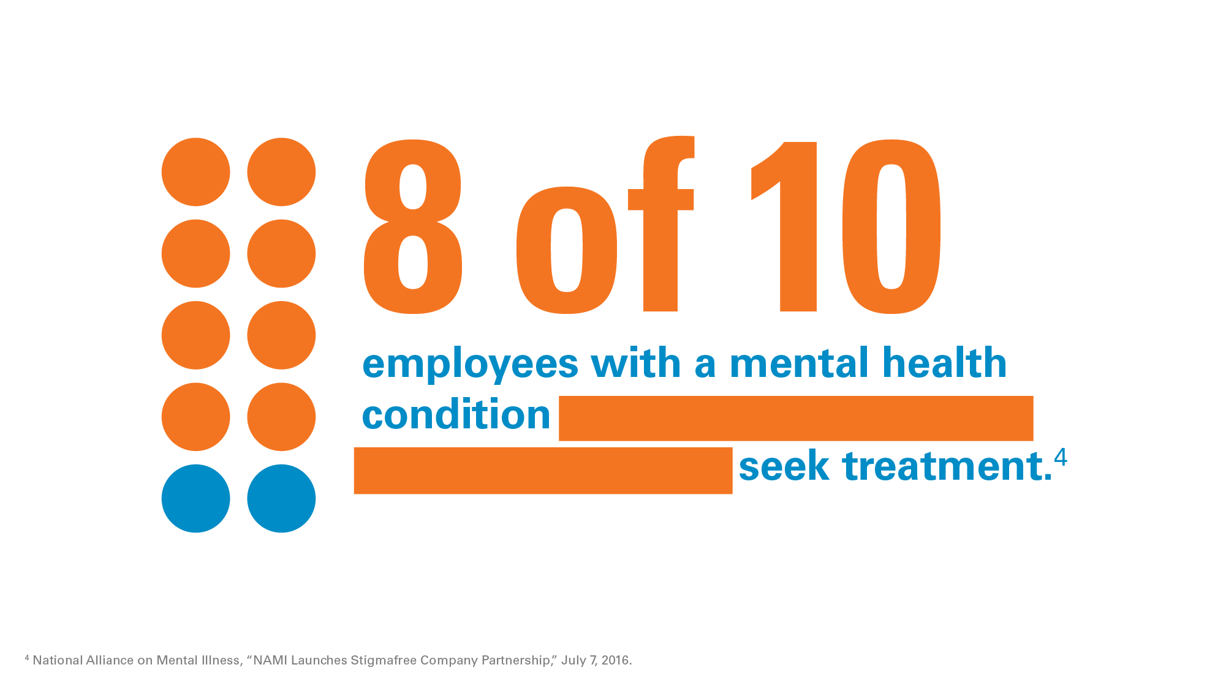
Notes:
But we can be part of creating change. We shared earlier just how important our role is. When we set the example, it encourages a majority of employees to feel they can speak up and seek support. Organizations that create cultures of health understand three key things:
• Leadership (and not just senior leadership, but all managers) needs to be openly engaged to make a significant impact.
• The importance of behavioral health needs to be fully infused into the culture.
• And available behavioral health resources need to be clearly communicated and promoted regularly in multiple ways, both formal and informal.
If we commit to this, we can change what’s normal. Particularly during these times of heightened anxiety, stress and uncertainty, it’s important that we address the barriers preventing us from taking care of our whole selves.

Slide 6
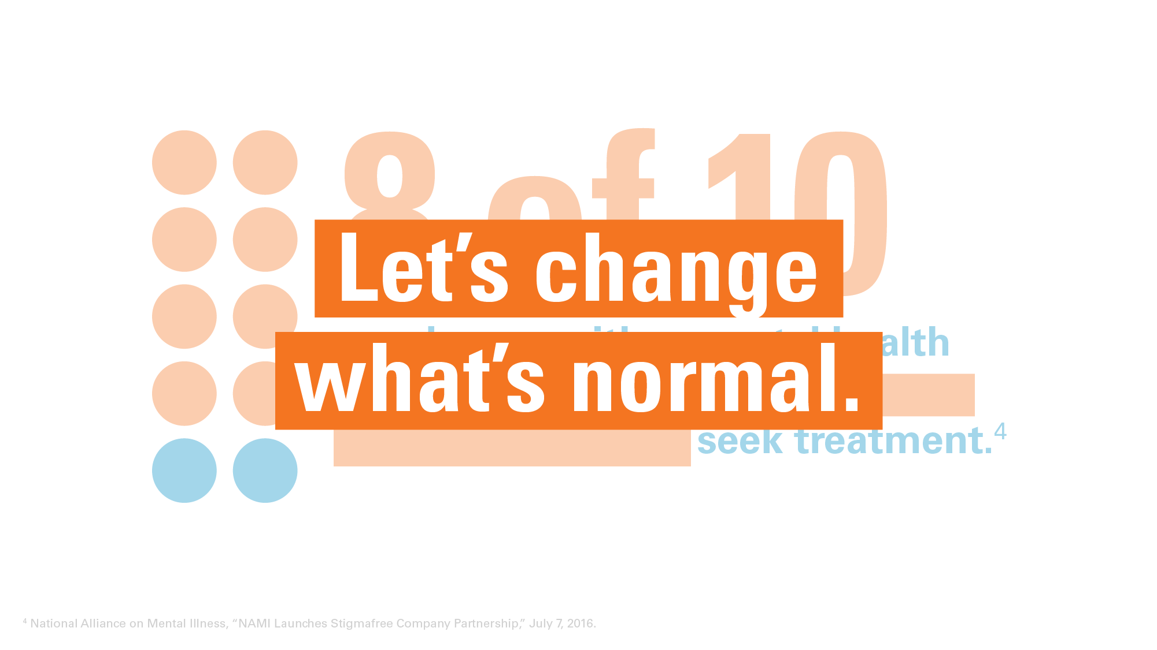
Notes:
The new normal needs to be employees talking about their mental health and getting support when they need it. This new initiative will help us do that.
• It will reach employees through our key channels of communication.
• It will engage them in relevant, interactive content.
• It will provide ways to break down this stigma while helping address everyday stress and the added dynamics of the pandemic.

Slide 7

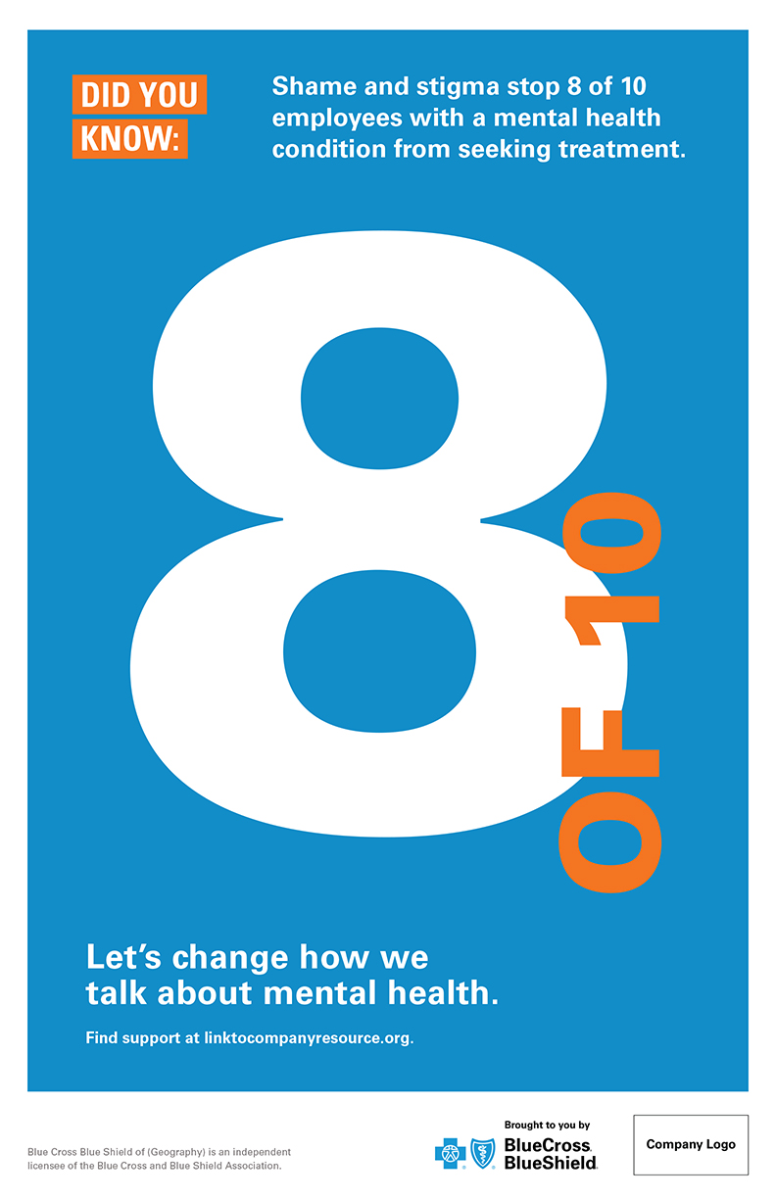
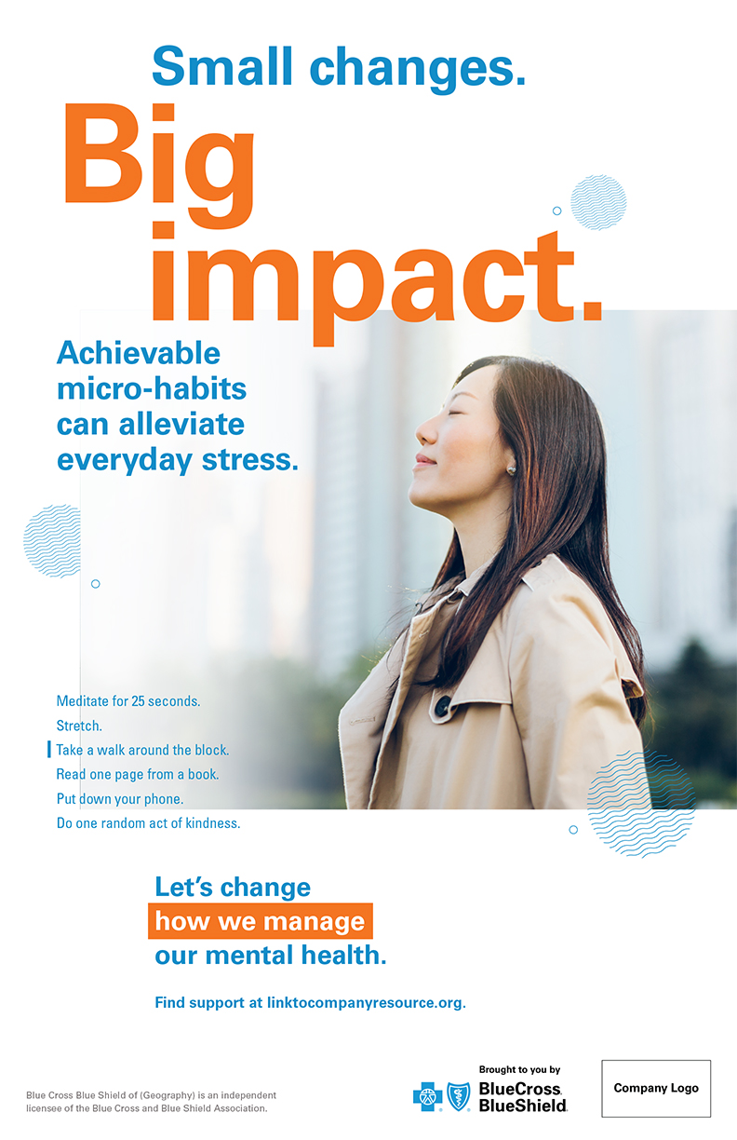
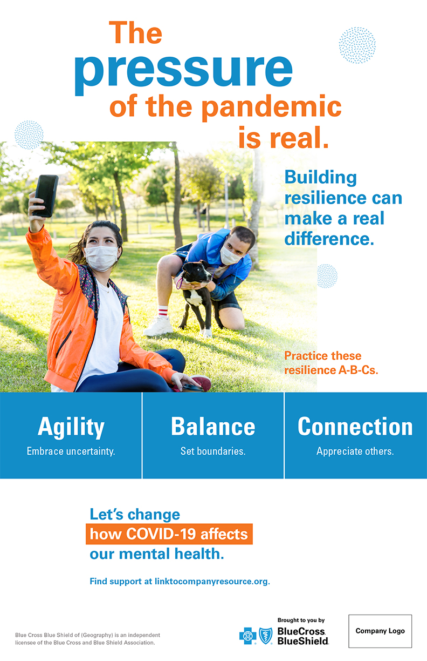
Find support at linktocompanyresource.org.
Notes:
What does this Behavioral Health Employee Communications Toolkit involve?
Well, the kickoff is an interactive Employee Presentation that you are encouraged to be a part of, in the spirit of setting the example and speaking openly and personally about the value of full health and behavioral health as part of it. Here’s what you can do:
• Raise your hand to help host or contribute to the presentation itself
• Raise your hand to help promote the employee presentation
• Think of personal experiences or connections to behavioral or mental health that you can commit to speaking more openly and regularly about
Following the presentation, there is a whole suite of internal communication materials including digital assets (emails, banners for our intranet, messaging for onsite digital screens, screensavers, etc.) and printed materials for use onsite(s) (posters, tent cards to place on tables, counters, workbenches, etc.).
• These materials will be filled with more information around the topics we’ve talked about today, and behavioral health support resources—plus tips on how to make caring for our full health a personal and organizational priority.
• Just as importantly, there will be reminders of this URL, where you can find resources that we as a company make available for us all and want you to use as you need.

Slide 8
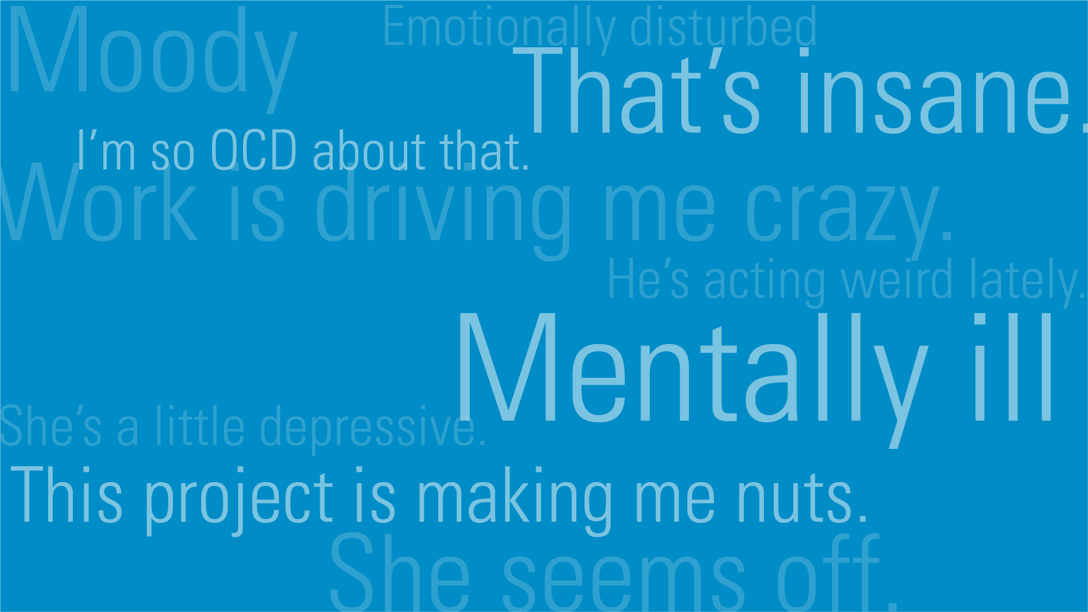
Notes:
You can’t begin to address employee behavioral health without talking about stigma. Studies show that shame and stigma are holding as many as 8 out of 10 people back from seeking treatment. The growing effect on not just our mental health, but our full health, is real. And increasingly, employees want to address it. In fact, 57 percent of employees say that to help reduce mental health stigma, it should be openly discussed in the workplace.
• But the reality is words are powerful and sometimes not in a good way. One reason stigma is so prevalent is that words like these are all around us.

Slide 9
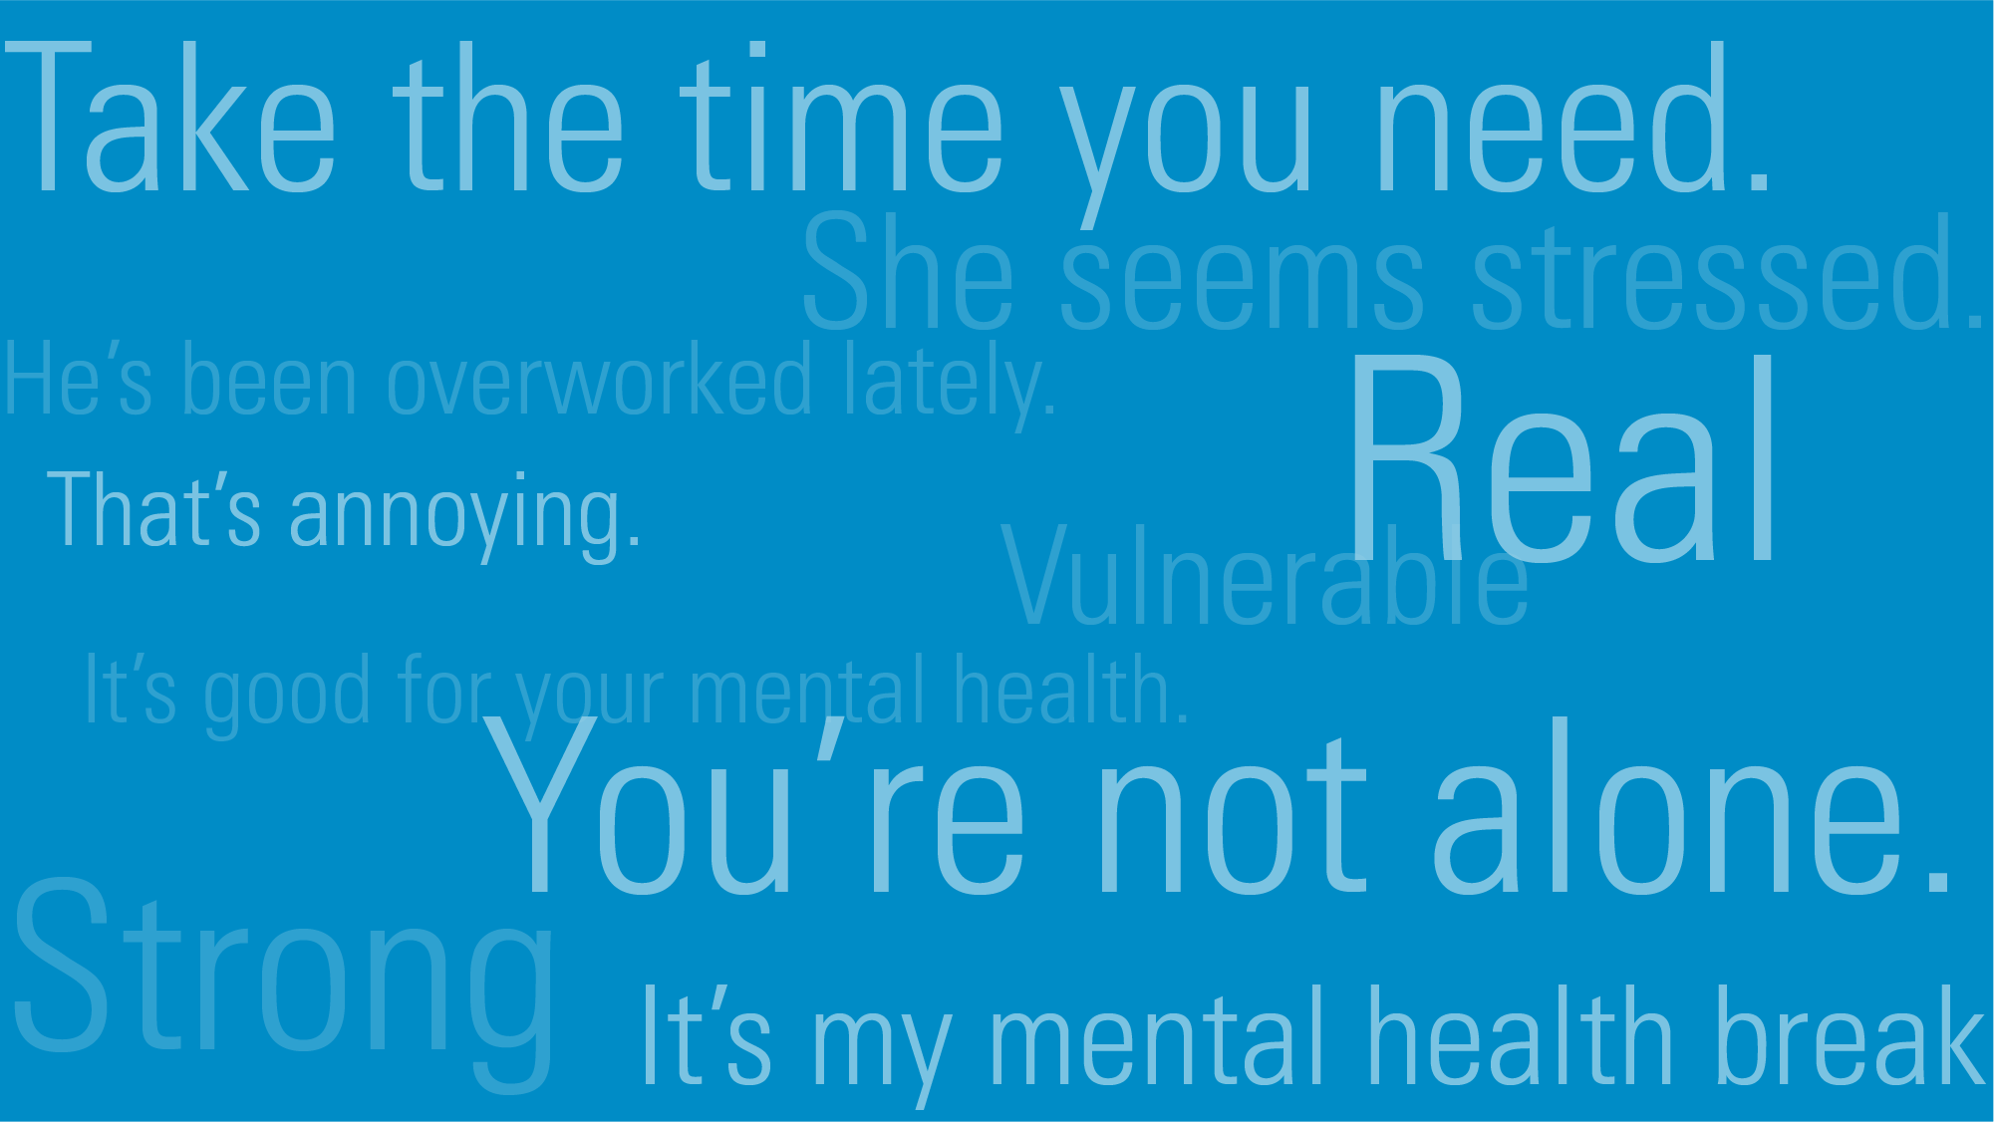
Notes:
This initiative will help us all see the language of stigma…And it will begin to give us better ways of talking about what we’re facing.

Slide 10
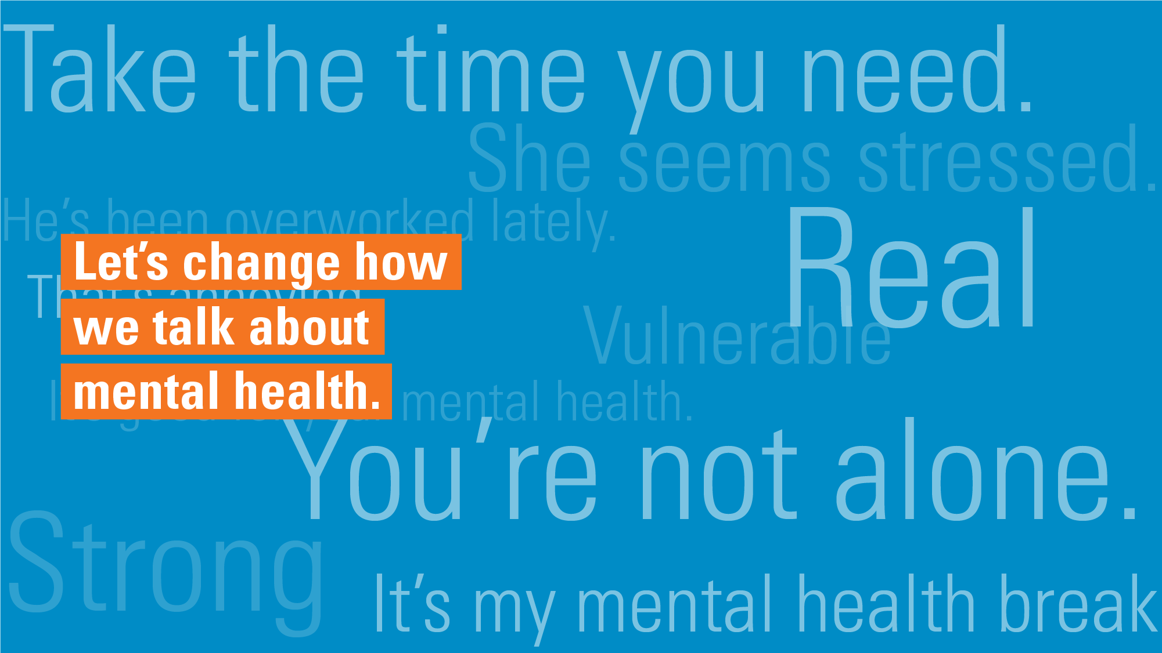
Notes:
As people. As employees. As a workforce.

Slide 11

Notes:
After talking about it, the next way to remove stigma is to value taking care of our mental health as something we need to do every day, just like we work out or walk or eat healthy to take care of our physical health.
• One survey found 40 percent of workers said their jobs were very or extremely stressful. This makes a lot of sense.
– The world and culture we live and work in is always moving.
– We are all juggling so much—between work, family, friends, finances, our faith, the news, many employees providing caregiving…fitting in caring for our physical and mental health can just feel daunting.
• But that’s why it can help to break things down. To look at what we’re facing in the moment, and find ways we can positively impact our health every day.

Slide 12
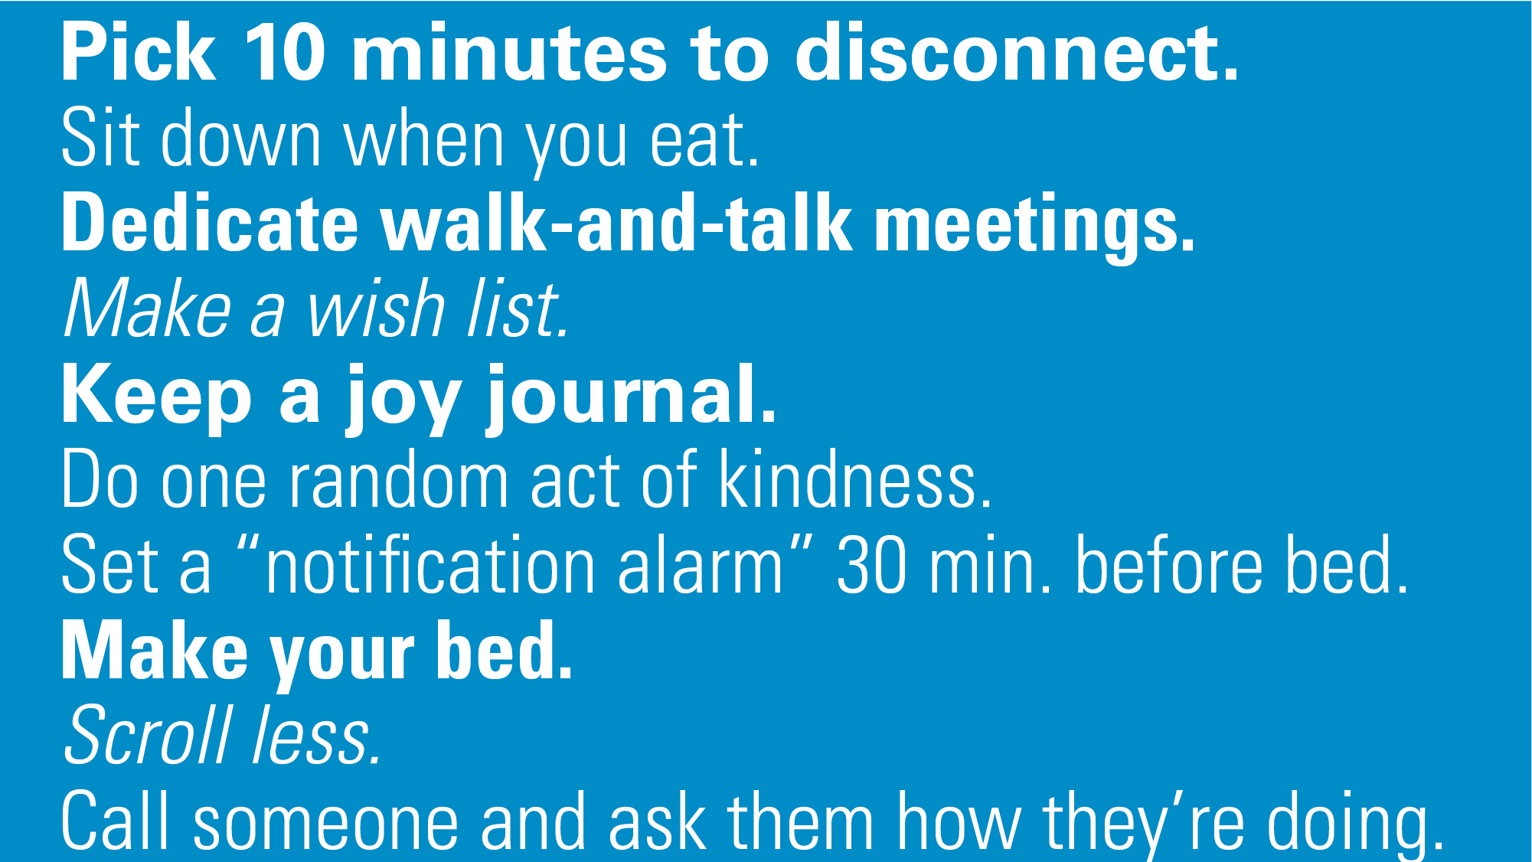
Notes:
That’s where micro-habits come in. This is an idea that experts are giving a lot of serious attention to right now.
• Micro-habits are focused on small habits we can fit into our busy lives every day, and that over time have the potential to have a big impact on our health.
• In fact, just take one of these—making your bed. One study of 68,000 people found that 71 percent of those who make their bed in the morning are happier, more likely to like their jobs and more well rested. Now, we have to remember that correlation does not always equal causation, but you get the point.
Our hope is that this culture-building communications toolkit will help all of us be more mindful of everyday ways that we can create and cultivate healthy habits and connect to the everyday support that will help with everyday stresses. Which is all the more critical in the face of continuing pressure related to the pandemic.

Slide 13
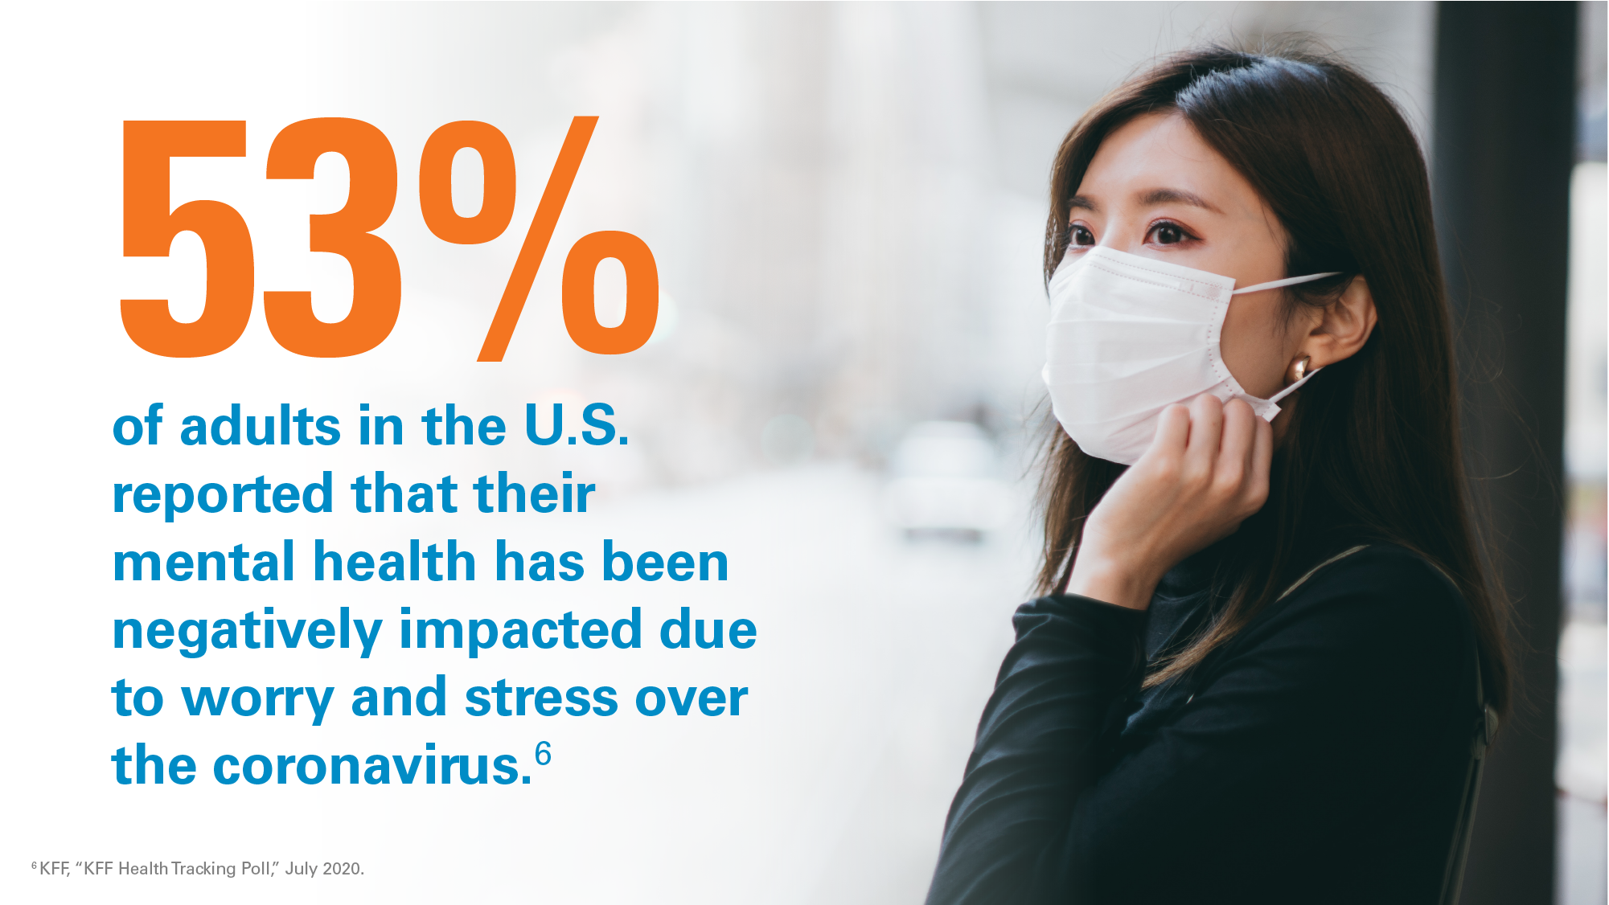
Notes:
For those anxious about the virus or worried about its impact on not just their physical health but their mental and emotional health, too—these communications can help assure them they are not alone.
• Fifty-three percent of adults in the United States reported that their mental health has been negatively impacted due to worry and stress over COVID-19.
• Many employees, even some who were not before, have found themselves taking on caring for a loved one. Because millennials are often in a special situation of caring for both children and parents at the same time, millennial employees are even more likely to experience stress-related conditions.

Slide 14
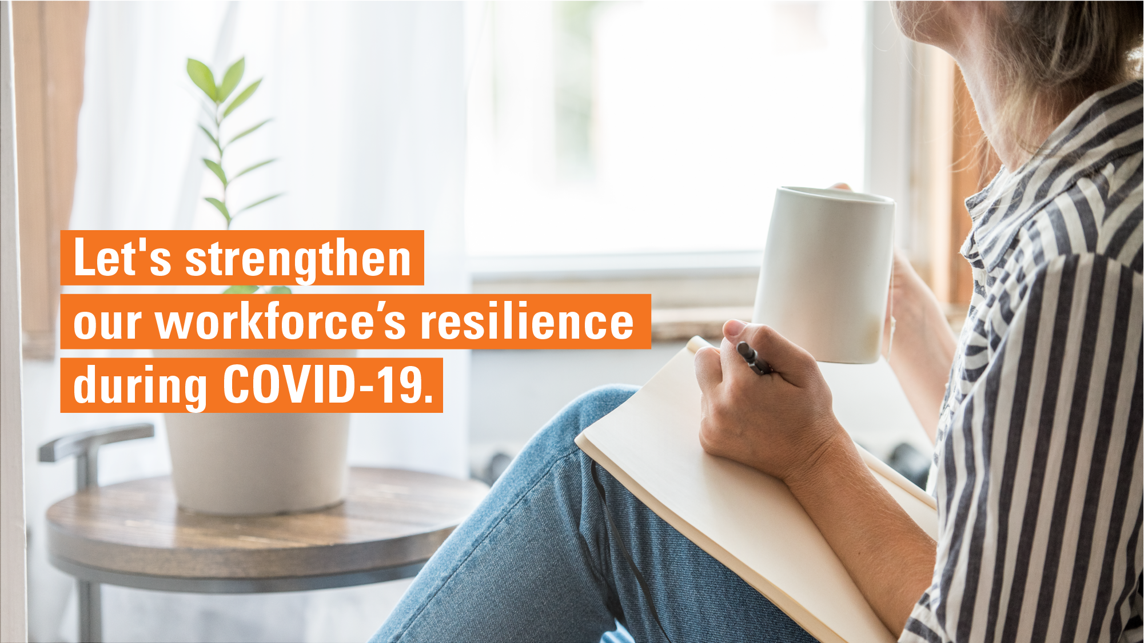
Notes:
The reality is, this stressor is unlike any other. It’s changing our work and home lives, and giving us all new challenges to deal with, which can have an effect on our mental health. To deal with something like a pandemic, it helps to nurture skills that build resilience and mental strength. Consider these ABCs:
• Agility—embrace uncertainty and constant changes by focusing on things you can control. This can be:
– Making a conscious choice to protect your behavioral health.
– Choosing to have a positive outlook.
– And acknowledging other places in life where uncertainty is normal.
• Balance—set boundaries to gain mental strength for work and life. This can be any boundaries you need that help manage the stressors that are putting pressure on your behavioral health:
– Setting and sticking to a work closing time, so you don’t overwork.
– Putting healthy limits on news-binging, so you avoid the stress that comes with oversaturation of COVID-19 coverage
– Finding time for self-care amidst childcare, etc.
• And connection—share concerns because when we’re not alone, we bounce back stronger together. This can be:
– Making a list of people who support you.
– Recognizing the people and things in your life that you’re grateful for. Reaching out to be there for others.
– Calling, talking and laughing with people who make you feel good.
– Seeking out help from a behavioral health professional if you’re feeling too overwhelmed.

Slide 15
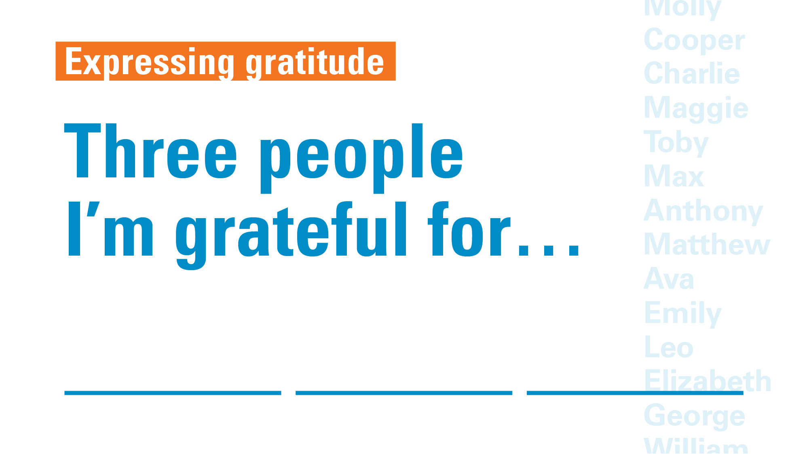
Notes:
This turnkey toolkit will educate and empower employees around skills that lead to the mental strength and resilience needed in the face of the pandemic.

Slide 16
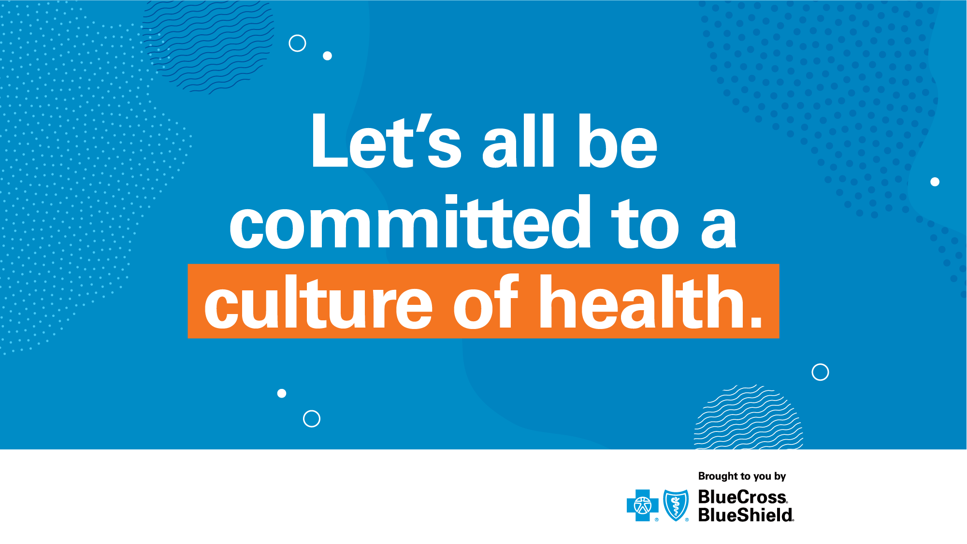
Independence Blue Cross offers products through its subsidiaries Independence Hospital Indemnity Plan, Keystone Health Plan East and QCC Insurance Company, and with Highmark Blue Shield — independent licensees of the Blue Cross and Blue Shield Association.
Notes:
All in all, this Behavioral Health Employee Communications Toolkit gives us a vehicle that can help drive a commitment to creating a culture of health.
Thank you all for your time, your participation, and for your interest in making a real difference in employees’ lives. What questions do you have?

